Slide 1

Dayananda Sagar University
Name: Sandeep Kumar K B
Roll No: 40
USN: ENG24CY0047
Section: 3B

Slide 2

Compressing and Decompressing Files with xz and unxz

Slide 3
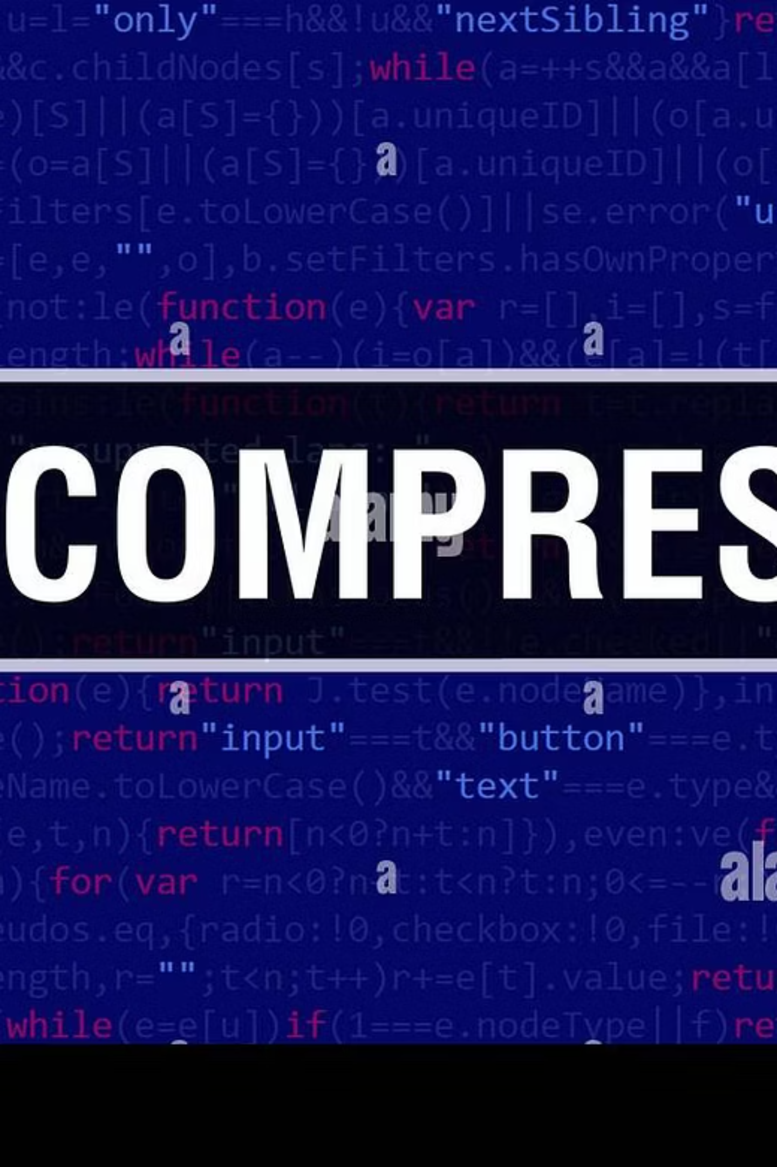






What is xz?
xz is a powerful command-line utility in Linux and Unix-like operating systems, renowned for its exceptional data compression capabilities. It leverages the advanced LZMA2 algorithm, which is a successor to the LZMA algorithm, known for providing very high compression ratios.
Linux Command-Line Tool
A native, robust compression tool for command-line environments.
Unlike older compression tools like gzip or bzip2, xz consistently achieves significantly smaller file sizes, making it an excellent choice for archiving large files, distributing software packages, or simply saving disk space.
LZMA2 Algorithm
Utilizes an advanced algorithm for superior compression efficiency.
.xz File Format
Supports the widely adopted .xz format, known for its efficiency in file archiving.

Slide 4

Basic Compression with xz
The Fundamental Command
To compress a file using xz, the basic command is straightforward: xz filename. When executed, xz processes the specified file, applies the LZMA2 compression, and then replaces the original file with its compressed version, which will have a .xz extension appended to its name.
For instance, if you have a text file named example.txt, running the command xz example.txt will result in the creation of example.txt.xz. The original example.txt will no longer exist in the directory, as it's replaced by the compressed version.
This default behavior ensures that disk space is immediately freed up by removing the uncompressed version, which is often desirable when dealing with very large files.
Command in Action
$ lsexample.txt$ xz example.txt$ lsexample.txt.xz
This demonstrates the typical workflow of basic xz compression.

Slide 5

Decompressing with unxz or xz -d
Restoring Your Files
When you need to access the contents of an xz-compressed file, you can easily decompress it using one of two primary methods:
unxz filename.xz: This is the most common and user-friendly command for decompression. It's essentially a symbolic link or a script that calls xz with the decompression flag.
xz -d filename.xz: This is the explicit way to tell the xz utility to decompress a file using the -d (decompress) option.
Both commands perform the same function: they take the .xz compressed file, extract its original content, and remove the .xz extension, restoring the file to its original name and state.
Decompression Example
$ lsexample.txt.xz$ unxz example.txt.xz$ lsexample.txt
Just like with compression, the original compressed file is removed by default after successful decompression.

Slide 6
Keeping Original Files During Compression/Decompression
By default, both xz and unxz remove the original file after the operation (compression or decompression). This behavior is designed to save disk space immediately. However, there are scenarios where you might want to retain both the original and the processed file. This is where the -k (keep) option becomes invaluable.
Compression with -k
Decompression with -k
When compressing, using xz -k filename will create the filename.xz file while leaving the original filename intact. This is particularly useful for creating backups or distributing a compressed version without deleting your working copy.
Similarly, for decompression, using xz -dk filename.xz (or unxz -k filename.xz) will extract the original filename while preserving the filename.xz file. This allows you to restore the uncompressed version for use while keeping the compressed archive readily available.
$ xz -k example.txt$ lsexample.txt example.txt.xz
$ xz -dk example.txt.xz$ lsexample.txt example.txt.xz

Slide 7

Controlling Compression Levels
xz provides a flexible range of compression levels, allowing users to balance between compression speed and the resulting file size. This is crucial for optimizing performance based on specific needs, such as quick transfers versus maximum storage efficiency.
1
2
3
Level 0: Fastest Compression
Level 9: Best Compression
Default Level: 6
This level offers the quickest compression time but results in the least amount of file size reduction. It's suitable for situations where speed is paramount and slight savings in file size are acceptable.
At the other end of the spectrum, level 9 delivers the highest compression ratio, producing the smallest possible file size. However, this comes at the cost of significantly increased compression time and memory usage. It's ideal for long-term archiving or when bandwidth is extremely limited.
If no specific level is provided, xz defaults to compression level 6. This level strikes a good balance between compression speed and efficiency, making it a generally well-suited option for most everyday tasks.
xz -0 filename
xz filename
xz -9 filename
For convenience, xz also offers symbolic aliases: --fast (equivalent to -0) and --best (equivalent to -9) to improve readability of commands.

Slide 8
Monitoring Progress and Forcing Operations
Verbose Output (-v)
Forcing Overwrite (-f)
When compressing or decompressing large files, it can be helpful to see the progress of the operation. The -v (verbose) option provides detailed output, including the percentage of completion, the compressed size, and the compression ratio. This gives you real-time feedback on how the process is unfolding.
By default, xz will not overwrite an existing compressed file or an existing decompressed file. This is a safety measure to prevent accidental data loss. However, if you are sure you want to replace an existing file, you can use the -f (force) option.
For example, if example.txt.xz already exists, xz example.txt would normally fail. But xz -f example.txt would proceed with the compression and overwrite the existing example.txt.xz.
$ xz -v largefile.datalargefile.data: 27.5 % -- 12.3 MiB / 44.7 MiB = 0.275largefile.data: 55.0 % -- 24.6 MiB / 44.7 MiB = 0.540...
Combined Example
To combine these options for a comprehensive operation, you can use them together:
xz -kf -v example.txt
This command would compress example.txt, keep the original file, force an overwrite if example.txt.xz already exists, and show verbose progress updates.

Slide 9



Compressing Multiple Files with tar and xz
While xz is excellent for compressing single files, it's not designed to handle multiple files or entire directories directly into a single archive. For such tasks, the venerable tar utility comes into play. tar (Tape Archiver) is used to combine multiple files and directories into a single archive file, often called a "tarball." This tarball can then be compressed using a tool like xz.
Step 1: Archive Files with tar
Step 2: Compress Archive with xz
Integrated Approach: tar -J
First, you'd typically use tar to create an uncompressed archive of your files and directories.
Then, you would compress the .tar file using xz.
For convenience, tar has an integrated option, -J, which tells it to pipe its output directly to xz for compression. This streamlines the process into a single command.
xz archive.tar
tar -cvf archive.tar *.txt
Result: archive.tar.xz
tar -cJvf archive.tar.xz *.txt
Here's a breakdown of the common tar options when used with xz:
-c: Create a new archive.
-J: Filter the archive through xz (for compression).
-v: Verbose output, showing the files being added to the archive.
-f: Specify the filename of the archive.
Extracting a .tar.xz Archive
To extract an archive compressed with tar and xz, simply use tar -xvf archive.tar.xz. The -J option is not explicitly needed for extraction, as tar intelligently detects the compression type based on the file extension.

Slide 10






Listing and Testing Compressed Files
After creating or receiving .xz compressed files or .tar.xz archives, it's often useful to inspect their contents or verify their integrity without fully decompressing them.
List Contents of .tar.xz Archive
Test Integrity of .xz File
View Compression Info (-l)
If you have a .tar.xz file (an archive created with tar and compressed with xz), you can list its contents using tar -tf. The -t option stands for "list" and -f specifies the archive file.
To ensure that an .xz file is not corrupted and can be successfully decompressed, you can use the -t (test) option with xz.
For detailed information about an .xz compressed file, including its uncompressed size, compressed size, compression ratio, and check integrity, use the -l (list) option.
xz -t filename.xz
tar -tf archive.tar.xz
If the file is intact, the command will complete silently with no output. If there's corruption, xz will report an error, indicating that the file might be damaged.
xz -l filename.xz
This command will display a list of all files and directories contained within the archive without extracting them.
This provides valuable metadata about the compressed data without having to decompress it first, useful for quick assessments.

Slide 11

Summary: Why Use xz?
xz stands out as a premier compression utility for a variety of reasons, making it an indispensable tool for anyone working with data in a Linux environment. Its advanced algorithm and thoughtful design offer compelling advantages over older compression methods.
Superior Compression Ratio
Achieves significantly smaller file sizes compared to gzip or bzip2, leading to substantial savings in disk space and reduced bandwidth consumption for data transfers.
Flexible Compression Levels
Offers a spectrum of compression levels (0-9), allowing users to fine-tune the balance between compression speed and file size, adapting to diverse operational needs.
Seamless Integration with tar
Works efficiently with the tar utility, enabling the creation of highly compressed archives (.tar.xz) for multiple files and directories with a single command.
Simple and Intuitive Commands
Features straightforward commands for both compression (xz) and decompression (unxz or xz -d), ensuring ease of use for single file operations.
Robust Data Integrity Checks
Includes options like -t (test) and -l (list) for verifying file integrity and viewing compression information, enhancing reliability in data management.

